Slide 1
Chapter 3
Discrete Random Variables
and
Their Probability Distributions

Slide 2
Objectives
Geometric Probability Distribution
Negative Binomial Distribution

Slide 3
Geometric Probability Distribution
This experiment involves identical and independent trials.
Experiment can result in one of two outcomes: success or failure.
The probability of success is equal to p and is constant from trial to trial.
However, instead of the number of successes that occur in n trials, the geometric random variable X is the number of the trial on which the first success occurs.
Thus, the experiment consists of a series of trials that concludes with the first success. Consequently, the experiment could end with the first trial if a success is observed on the very first trial, or the experiment could go on indefinitely.

Slide 4
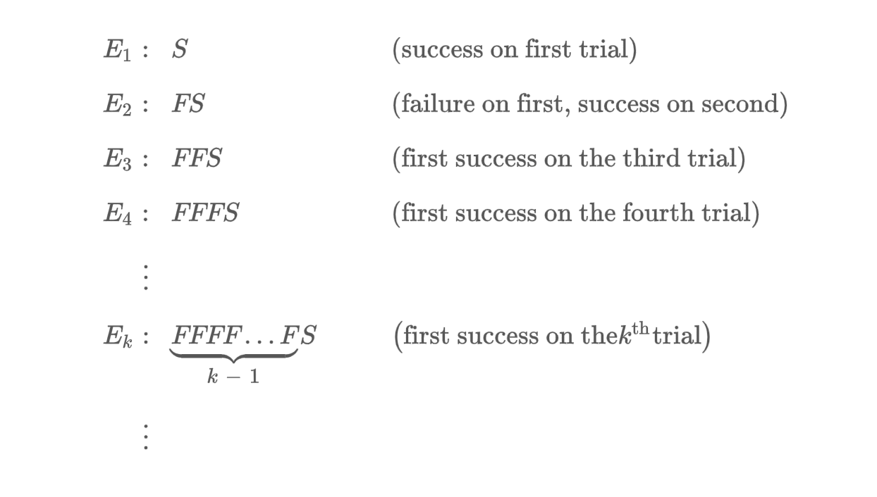
Geometric Probability Distribution
The sample space for the experiment contains the countably infinite set of sample points:

Slide 5

Geometric Probability Distribution
A random variable X is said to have a geometric probability distribution if and only if
$P\left(X=x\right)= q^{x−1}$p, x = 1,2,3, …., $0≤p≤1$

Slide 6
EXAMPLE
Suppose that 30% of the applicants for a certain industrial job possess advanced training in computer programming. Applicants are interviewed sequentially and are selected at random from the pool. Find the probability that the first applicant with advanced training in programming is found on the fifth interview.
Sol:
Let X be the number of candidate interviewed until an applicant with advanced training in programming is found.
Then P(X=5) = (0.7)⁴(0.3) = 0.07203

Slide 7

Geometric Probability Distribution
If X is a random variable with a geometric distribution,
$$μ=E\left(X\right)= \frac{1}{p}$$
$$σ^{2}=V(X)= \frac{1−p}{p^{2}}$$

Slide 8
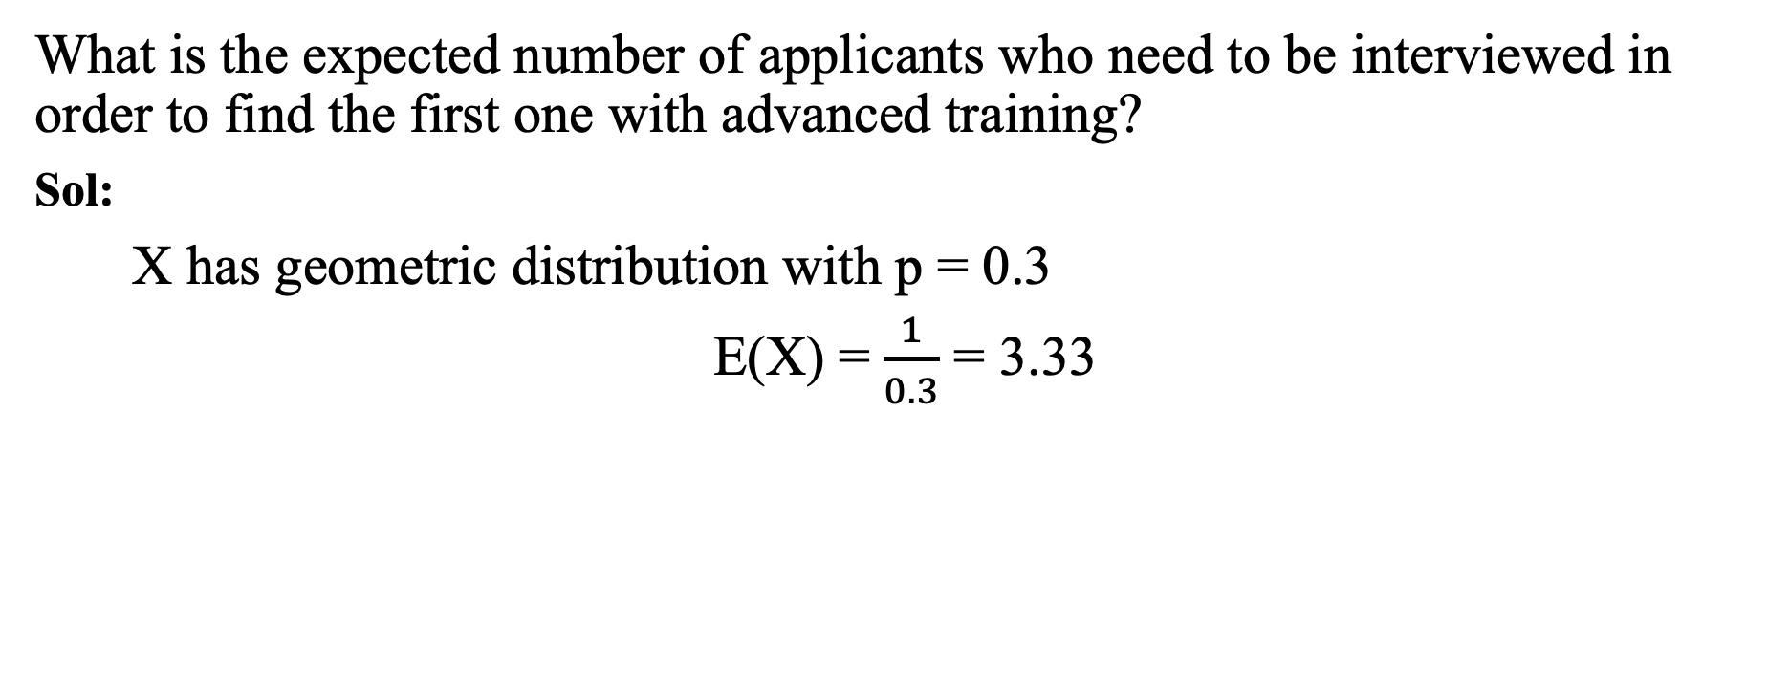
EXAMPLE (cont’d)
What is the expected number of applicants who need to be interviewed in order to find the first one with advanced training?
Sol:
X has geometric distribution with p = 0.3
E(X) = $\frac{1}{0.3}$ = 3.33

Slide 9
The Negative Binomial Distribution

Slide 10
The Negative Binomial Distribution
The experiment consists of a sequence of independent trials.
Each trial can result in either a success (S) or a failure (F).
The probability of success is constant from trial to trial, so for i = 1, 2, 3, …
The experiment continues (trials are performed) until a total of r successes have been observed, where r is a specified positive integer.

Slide 11

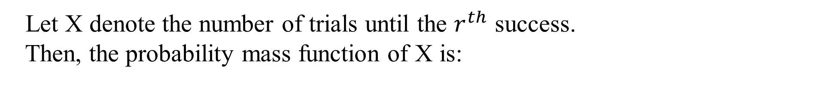
The Negative Binomial Distribution
Let X denote the number of trials until the $r^{th}$ success.
Then, the probability mass function of X is:
for x = r, r+1, r+2,….
In this case, we say that X follows a negative binomial distribution.
X is called a negative binomial random variable because, in contrast to the binomial rv, the number of successes is fixed and the number of trials is random.

Slide 12

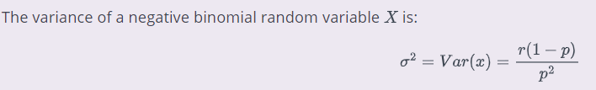
The Negative Binomial Distribution
Prove these!

Slide 13

Example
A pediatrician wishes to recruit 5 couples, each of whom is expecting their first child, to participate in a new natural childbirth regimen.
Here, S = {couple agrees to participate}
Let p = P(S) = 0.2.
What is the probability that 15 couples must be asked before 5 are found who agree to participate?

Slide 14
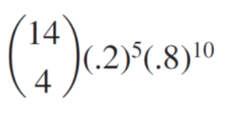
Example
What is the probability that 15 couples must be asked before 5 are found who agree to participate?
Substituting r = 5, p = .2 , and x = 15 gives
P(X=15) =

Slide 15
The Negative Binomial Distribution
The random variable of interest is
X = the number of failures that precede the r^{th} success;
Possible values of X are 0, 1, 2, . . . .

Slide 16
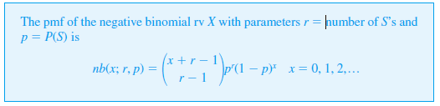
The Negative Binomial Distribution
Generalizing this line of reasoning gives the following formula for
the negative binomial pmf.

Slide 17
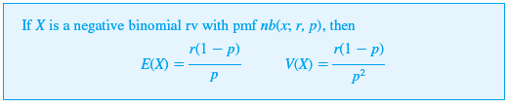
The Negative Binomial Distribution

